Slide 1
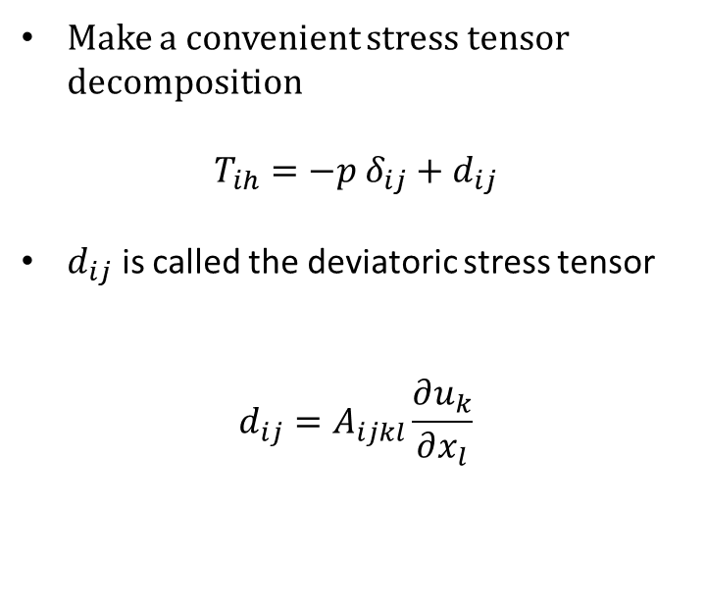
Make a convenient stress tensor decomposition
$$T_{ih}=−p δ_{ij}+d_{ij}$$
$d_{ij}$ is called the deviatoric stress tensor
$$d_{ij}=A_{ijkl}\frac{∂u_{k}}{∂x_{l}}$$

Slide 2








$\vec{t}$
$$δS^{\left(1\right)}$$
$${\hat{n}}^{\left(1\right)}$$
$$δS^{\left(2\right)}$$
$\hat{n}$
$${\hat{n}}^{\left(2\right)}$$
$${\hat{n}}^{\left(3\right)}$$
$$δS^{\left(3\right)}$$

